Slide 1

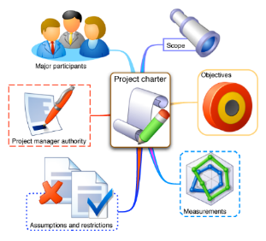

IMAT 5314 MSc Dissertation Project
Introduction
Professor Laurence Brooks
Module Leader
[Laurence.Brooks@dmu.ac.uk]
This Photo by Unknown Author is licensed under CC BY-SA-NC

Slide 2
Overview
Your project
Types of project
Proposing an idea
Terms of reference
Ethics form
The work
Writing a report
Viva
Procedures
Supervision
Dates
Delays
Assessment procedure

Slide 3
Project
Project
Taught 1
Taught 2
One Third of a Master’s Degree
The difference between an MSc and a PGDip
Substantial piece of independent creative work
Masters-quality intellectual rigour and depth
Detailed guide to what to do and how to do it on Blackboard
IMAT 5314 MSc Project Guide

Slide 4

People Involved
Student
1st Supervisor
2nd Marker
Programme Leader
MSc Project Module Coordinator (Laurence Brooks)
This Photo by Unknown Author is licensed under CC BY

Slide 5
PGT Calendar
Today
Start
Finish

Slide 6

Dates
Nominal duration
14 weeks for full time
11 months for part time/DL
Semester 3, 2019/20 (full time):
Start: Wednesday 27 May 2020
End: Friday 04 September 2020
This Photo by Unknown Author is licensed under CC BY-NC-ND

Slide 7

Picking a project: Your goals
What fits your MSc course?
Intellectual content
Range of skills
What do you want to
Want to Learn?
Want to Practise?
Want to do afterwards?
Enjoy doing?
This Photo by Unknown Author is licensed under CC BY-SA-NC

Slide 8
Picking a project: What kind?
Different kinds of project
Development: Build some software or machine
Research: Investigate a research question: Do and write about some primary research
Literature study: Investigate a research question: Produce a novel analysis based on written sources
Consultancy: Analyse a practical problem
Data analysis: Figure out how to answer particular kinds of data analysis questions
Conceptual analysis: Figure out how something works or could or should be done, or develop or apply analytical technique to a problem

Slide 9

How much research?
This Photo by Unknown Author is licensed under CC BY
All projects must have some significant research/fact-finding element
Essential requirement for Masters-quality work
Essential to be aware of the state of the art of research and technology
Essential to set development etc in context
Balance between research and development/consultancy/data analysis/whatever can be struck to suit each individual project
Hybrid projects with significant research and development welcome

Slide 10

How much research?
An MSc project is supposed to be scholarly work
Just building something and writing about it isn’t enough
You need research questions to answer: What will your work tell you?
Your dissertation needs a critical review of your project, including an attempt to answer your research questions
Most projects are primarily system development: You can use your system to address questions
See ‘Formulating Research Questions for Development Projects’
This Photo by Unknown Author is licensed under CC BY-SA

Slide 11

Picking a project: Ideas
You need something to DO
A vision of what you want to accomplish
What’s your two-sentence sales pitch?
Ideas from
You
DMU staff – lots on Blackboard
Clients
This Photo by Unknown Author is licensed under CC BY

Slide 12

Picking a project: Your Supervisor
Two main routes to finding a supervisor:
The preferred route – you have an idea, you look at the interests of the members of academic staff in the School
You approach the people who you think would be a good ‘fit’ as supervisor (usually email first, then go meet them)
If you have chosen a project put forward by a staff member, then obvious to contact that person and see if they have space to supervise you
If they don’t then back to approaching other people to see if they are willing to supervise
The non-preferred route – you give an indication of your topic (more than just a title) and a supervisor is ‘allocated’ to you
The downside of this is that the supervisor may not be so interested in the topic or have the exact set of knowledge and skills for that specific project, but all members of academic staff can supervise the process
It takes longer to make these allocations, as the preferred route takes place first
This Photo by Unknown Author is licensed under CC BY

Slide 13

Picking a project: Objectives
Development projects need…
A clear vision of what it is and how it will be used
Detailed requirements and product objectives
Projects that can be done incrementally are good…
Producing a pass-grade project is straightforward
Pass-grade project can be extended step by step into something wonderful

Slide 14

Picking a project: Questions
Research projects need
Clear focus on topic
Specific questions to investigate
Don’t get hung up on one question
Pays to have lots of questions: broad, narrow, concrete, theoretical…
But then find your focus!
Follow up what you can find something out about
Can invent more questions when you have answers for them
Can throw away unsuccessful questions IF you have others…
This Photo by Unknown Author is licensed under CC BY-SA

Slide 15

Terms of Reference (ToR): Aim
ToR is recommended for the project module
Aim is clear vision of what the project is
Agreement on a feasible project
Clear shared understanding of aims
Clear shared understanding of development process
Quality check on planning

Slide 16

Terms of Reference: Content
Header: Name, title, etc
Background: What the problem is, and how you’ll do it
(Deliverables: What you’ll produce)
Academic aim: What you want to learn
Research questions: What you want your system, research, etc, to tell you
Research literature: What you’ll write about for the research component of your report
Resources required: What you’ll need, if non-standard
Risk assessment: What might go wrong, and what your backup plan is

Slide 17
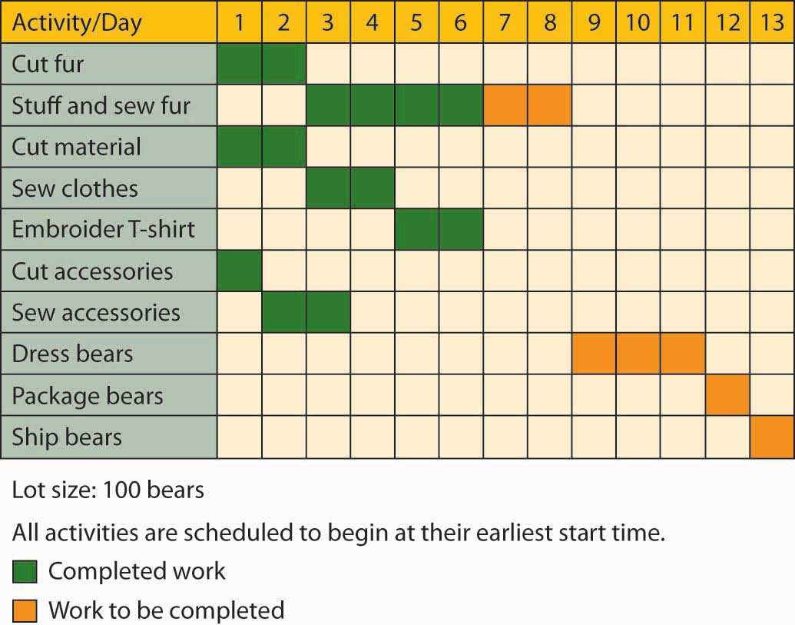
Terms of Reference: Time Plan
Schedule of activities is essential
Helps you to think about what you need to do, in what order and how long you have for each major activity
Gantt Charts are customary
Need to decompose programming and other activities in a lot of detail
Too easy to get lost in a long bar called ‘coding’

Slide 18

The Ethical Review Form
Application to Gain Ethical Approval
Mandatory for ALL projects
No interaction with other people
Participants are adults who understand the research
Participants include potentially vulnerable people, such as children or subordinates in power relationships; or research about illegal activities; or risk of injury; etc
Ethically questionable
Outcomes 3 or 4 need to go to FREC
This Photo by Unknown Author is licensed under CC BY

Slide 19
The Work
Varies between projects…
But needs to include an element of background learning and analysis
Literature review and/or fact finding
Plan for this needs to be in ToR
Needs to consider scholarly questions
Always wise to write pieces of report as you go along
Summaries of papers
Summaries of interviews
This Photo by Unknown Author is licensed under CC BY

Slide 20

The Work: Get feedback
Your supervisor can only help if you turn up with ideas and produce stuff to critique
Development
Requirements, design documentation, etc, needs to be precise and detailed enough to be wrong
Don’t be afraid of being wrong, be afraid of being too vague
Research
The time when you want the sharpest criticism you can get for love or money is before you run a data gathering activity

Slide 21

Report: Deliverables
Turnitin submission via Blackboard only!
Your supervisor may appreciate a hard copy – ask!
Agree deliverables and structure with supervisor
Dissertation Report + Product (code or paper)
Evidence of research and critical analysis
Critical review of product
Critical review of project
This Photo by Unknown Author is licensed under CC BY-SA-NC

Slide 22

Report: Your Own Work
…except where you say it isn’t
Referencing needs to be honest, clear, accurate
Previous work
Ideas
Quotations
No mercy for plagiarists
Not much mercy for insufficiently careful referencing
Use of bibliographic databases, ie. Refworks (see library), Zotero, Mendeley
This Photo by Unknown Author is licensed under CC BY-NC-ND

Slide 23
Report: Referencing
Consistent application of a standard reference format
Name and Date citations in text (Brooks, 2018)
‘DMU Harvard’
American Psychological Association (APA)
Use referencing tool, eg. Refworks, Zotero, Mandeley

Slide 24

Viva
Essential: No viva = non-submission of project = fail!
Depending on the circumstances, then a ‘virtual viva’ may be acceptable, ie. via MS Teams, Skype, Zoom, etc.
Seriously unsatisfactory viva can result in failure of entire project
Agree date, time and procedure with supervisor and second marker
After Deadline Day
Normally 30-60 minutes
Normally Presentation plus questions
Opportunity to show off what you’ve done
Opportunity for supervisor and second marker to ask any questions they think they need to ask
This Photo by Unknown Author is licensed under CC BY-NC-ND

Slide 25

Marking
Multi-stage procedure
Marked independently by supervisor and 2nd marker
Discussion to reach mark
Moderation
Review by external examiner
Assessment Board
It’s Official

Slide 26


Marking criteria
Overall academic judgement of quality of entire project
A distinction level overall means that the candidate must:
demonstrate an authoritative grasp of the conceptual context within which the work was undertaken;
display originality, insight and powers of in-depth critical analysis in the solution offered and/or is able to sustain an argument displaying originality, insight into current debates and conceptual position, in-depth critical analysis, and expresses this argument clearly, concisely and accurately;
demonstrate a high degree of relevant technical competence.
Mark all the key elements:
Problem framing, including research questions
Fact-finding and literature review
Research and development
Critical evaluation
Dissertation and documentation
Viva
This Photo by Unknown Author is licensed under CC BY-SA

Slide 27
Threshold criteria
Note that whatever grade you get in your dissertation, that is the maximum overall level you can get for your MSc!
For PASS (50%+)
For MERIT (60%+)
For DISTINCTION (70%+)
A seriously unsatisfactory viva is a fail, regardless

Slide 28
Marking criteria

Slide 29

Delays
Extensions: Temporary serious interruption; module leader can authorize up to 2 weeks
Deferrals: Major problem causing much longer delay; deferral panel can authorize later deadline
Form to be submitted online (usually with evidence)
https://www.dmu.ac.uk/current-students/student-support/exams-deferrals-regulations-policies/deferral-of-assessments.aspx
Interruptions of study: Future event preventing further work; suspension of entire degree for agreed period (never retrospective)
Consult supervisor as quickly as possible
Get reliable information

Slide 30


Projects in a Pandemic
This Photo by Unknown Author is licensed under CC BY-NC
DMU library still available online
Lots more really good resources and support currently available remotely: https://library.dmu.ac.uk/remote
Especially additional access to e-resources: https://library.dmu.ac.uk/eresourcesaccess
Unlimited access to library-owned ProQuest Ebooks, includes information on research methods: https://ebookcentral.proquest.com/lib/dmu
Very good set of resource pointers on how to do research in a limited environment
Lupton, D. (editor) (2020) Doing fieldwork in a pandemic (crowd-sourced document). Available at: https://docs.google.com/document/d/1clGjGABB2h2qbduTgfqribHmog9B6P0NvMgVuiHZCl8/edit?ts=5e88ae0a#
LSE Digital Ethnography Collective Reading List SHARED DOC - March 2020: https://zoeglatt.com/wp-content/uploads/2020/03/LSE-Digital-Ethnography-Collective-Reading-List-March-2020.pdf
Think about what is possible/reasonable if doing a development project or need specialist equipment
This Photo by Unknown Author is licensed under CC BY-NC-ND

Slide 31

Questions

